Slide 1
Customer Credit Default Prediction
AAI500 - Applied Artificial Intelligence
San Diego University
Team Members:
Anugrah Rastogi
Mallesham D
Dhrub Satyam
Instructor: Azka Azka

Slide 2
Team Members & Their Contributions
Anugrah Rastogi
Data Preparation
EDA
Plot and Analysis
Dhrub Satyam
Designed and tuned all ML models
Performed GridSearchCV and interpreted classification metrics
Mallesham D
Final analysis
Conclusions and Report

Slide 3
Abstract
Aim:
Predict customer credit default using machine learning.
Data:
70K training, 33K test records with 80+ features.
Methods:
Data cleaning, One hot encoding, RobustScaler.
Models:
Logistic Regression, Decision Tree, Random Forest, XGBoost.
Outcome:
Random Forest performed best in accuracy and interpretability.
Suggestion:
Deploy Random Forest with periodic fairness and performance audits.

Slide 4

Introduction
Problem
Credit default prediction helps financial institutions manage risk.
Objective
Build ML models using behavioral & demographic data to predict defaults.
Dataset
Public Kaggle dataset (2023) with various personal and financial attributes.
Goal
Develop interpretable, accurate, and deployable predictive models.

Slide 5
Real-World Motivation
Banks need to detect defaulters before credit approval.
Reduces financial losses, speeds up approvals, and improves compliance.
We used machine learning to automate and improve this prediction process using real customer data.

Slide 6
Data Handling & Preparation
Dataset Overview
Feature Scaling
70,000 training records with 82 features
33,000 test records with 80 features.
Used RobustScaler to minimize effect of outliers.
Missing Values
Target
Filled missing numeric values using median
0 - Non-default, 1 - Default.
Categorical Features
Feature Alignment
One hot encoded
Ensured consistency across training and test datasets.

Slide 7

Exploratory Data Analysis
Univariate: Skewed income & debt ratios; high outliers.
Bivariate: Default correlates with high debt_ratio and dependents.
Target Distribution: Imbalanced (Default: 20.6%, Non-default: 79.4%).
Actions Taken:
Used class weights to handle imbalance.
Applied robust scaling.
Chose tree-based models due to low correlation among features.
Used boxplots, heatmaps, and PR curves for insights

Slide 8
Feature Selection
Why?
Original dataset contained 189 features
Reduces overfitting and model complexity
Improves training speed and generalization
Helps eliminate noise and irrelevant information
Technique 1: Information Value (IV)
Measures strength of a feature in separating target classes
85 features removed due to low or suspicious IV values
Technique 2: Pearson Correlation
Identifies multicollinearity between features
Highly correlated features (≥ 75%) are redundant
16 features removed due to high pairwise correlation

Slide 9
Model Selection Overview
Models Tested:
Logistic Regression (baseline, interpretable)
Decision Tree (visual, simple)
Random Forest (ensemble, robust)
XGBoost (high accuracy, regularized)
Tuning Tool:
GridSearchCV with 5-fold CV, optimized for ROC AUC.
Metrics:
ROC AUC, F1, Precision, Recall

Slide 10




Classification Metrics
Precision
Of predicted defaulters, how many were correct?
Recall
How many actual defaulters were identified?
F1 Score
Balance between Precision & Recall.
ROC AUC
Ability to distinguish between default & non-default across thresholds.

Slide 11
Model Performance (Validation Results)
Model | Accuracy | ROC AUC | F1 Score (Class 1) | Precision (Class 1) | Recall (Class 1)
Random Forest | 0.91 | 0.9633 | 0.8049 | 0.85 | 0.76
XGBoost | 0.90 | 0.9576 | 0.7906 | 0.82 | 0.76
Decision Tree | 0.85 | 0.8808 | 0.6855 | 0.75 | 0.63
Logistic Regression | 0.83 | 0.9057 | 0.7134 | 0.63 | 0.82
Best model: Random Forest due to high ROC AUC and F1 score.

Slide 12
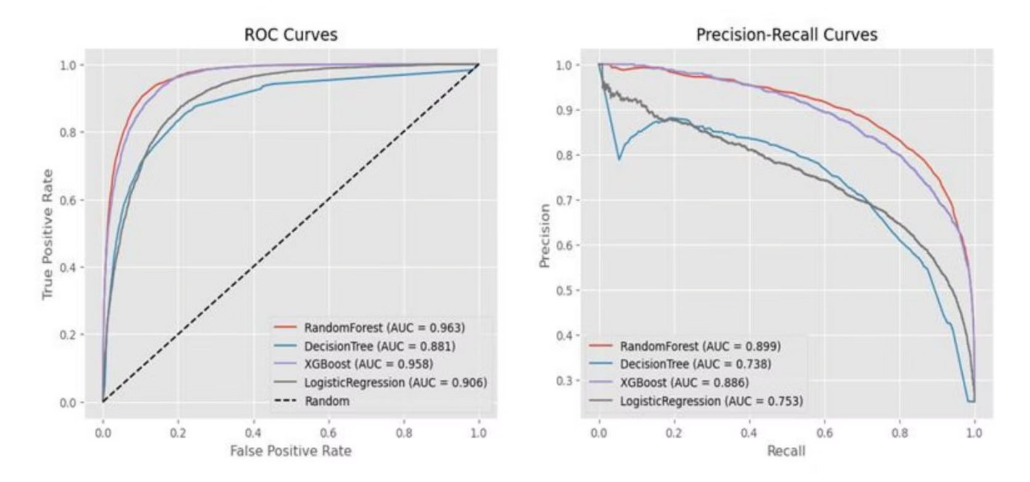
Visualizations
ROC Curve: Illustrates the trade-off between True Positive Rate and False Positive Rate.
Precision-Recall Curve: Useful for imbalanced datasets, focusing on the minority class.
Model Comparison Bar Chart: Visually compares ROC AUC and F1 scores across all models.

Slide 13
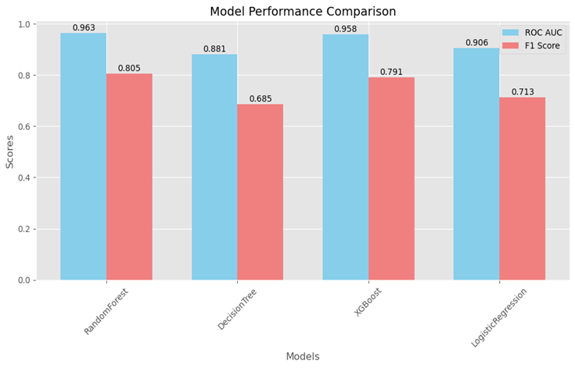
Visual Results
Random Forest
XGBoost
Logistic Regression
Decision Tree

Slide 14

Final Model - Random Forest
Most reliable in detecting defaulters and avoiding false positives.
Handles noise and outliers effectively.
Suitable for mixed data types (numerical + categorical).
Best performance on:
Accuracy: 91%
ROC AUC: 0.9633
F1 Score: 0.8049

Slide 15
Business Impact
Benefits:
Early identification of high-risk customers
Faster loan approvals for low-risk profiles
Supports compliance with explainable decisions
Cuts operational cost via automation.

Slide 16
Final Recommendations
Deploy Random Forest model in production.
Implement:
Continuous monitoring
Fairness and bias audits (e.g., gender, age groups)
Periodic tuning
Explainability tools like SHAP / LIME
Advanced ensemble techniques (stacking RF + XGBoost)

Slide 17

Conclusions
Built multiple models to predict credit default.
Random Forest emerged best for deployment.
Logistic Regression: Good recall, poor precision.
Decision Tree: Too simple.
XGBoost: Promising alternative, slightly behind Random Forest.

